Slide 1
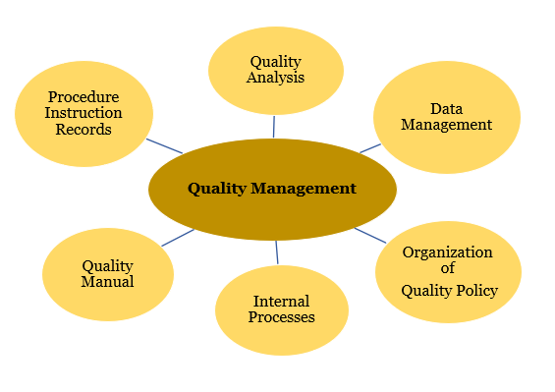
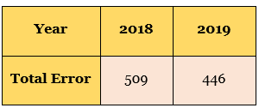
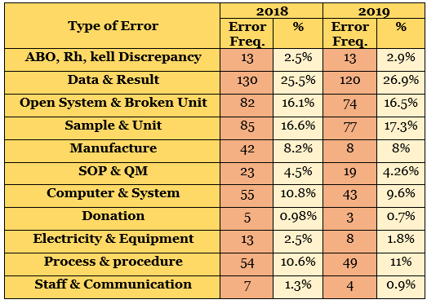
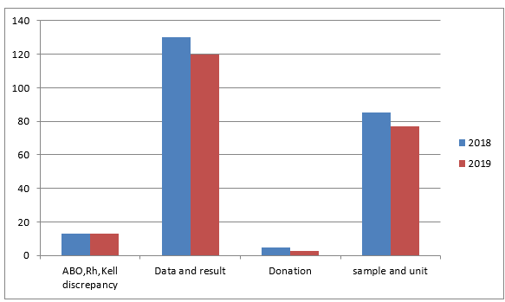
Title of The Project
Presenter name and Supervisor
Department, Faculty of Allied Health Sciences, Kuwait University
Background
Results
Discussion
Fill in from your introduction
List your results from your Results section
Write your discussion
Table 1: Example for table from a project
Conclusion
Write your conclusion
Figure 1: Example for table from a project
Purpose
Acknowledgments
Write the aim of the study
Write your acknowledgment
Table 2: Example for table from a project
Methodology
References
Explain your materials and methods in brief
Selected references for the information you provided in th background and/or discussion
Figure 2: Example from a project
Notes:
Handler

